Slide 1
Introduction
A client would like to open a business at Downtown Toronto but he is not sure what type of business or which Neighbourhood will make a good investment.
Data
Used wikipedia Canada postal codes (Link) to identify number of neighbourhoods in Downtown Toronto.
Use foursquare data to identify which is venues are most frequency searched in Downtown Toronto.
Methodology
Used supervised classification to identify the right business and neighborhood.
Because classification is useful when question can be expressed as associations between feature and target variables, especially when labelled data is available.
Used foursquare to identify the top 50 most popular searched venues in Downtown Toronto

Slide 2
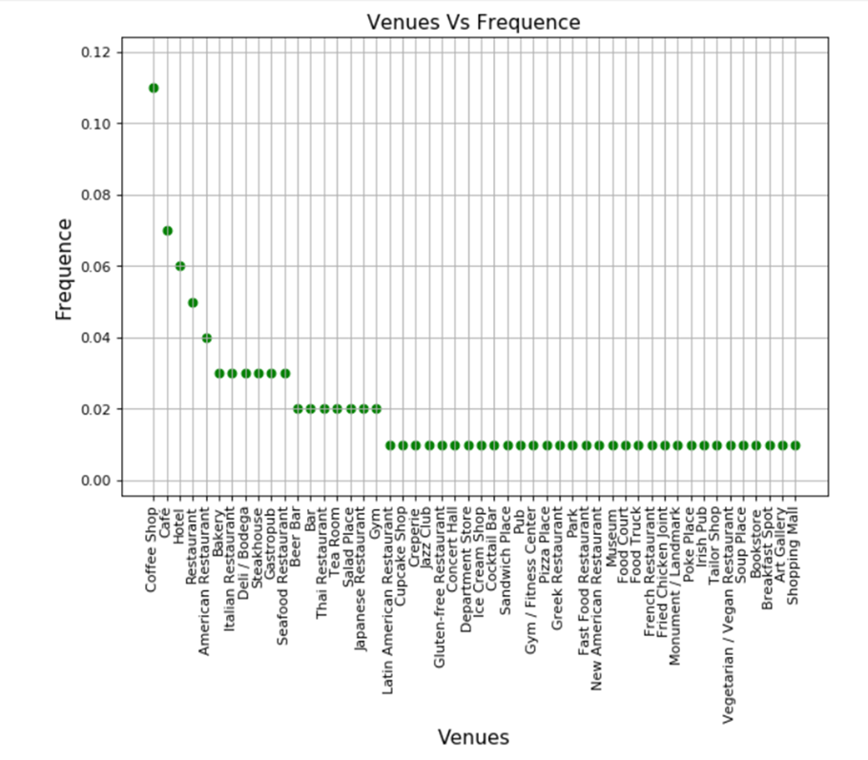
Coffee shop and Café are the most searched venues

Slide 3
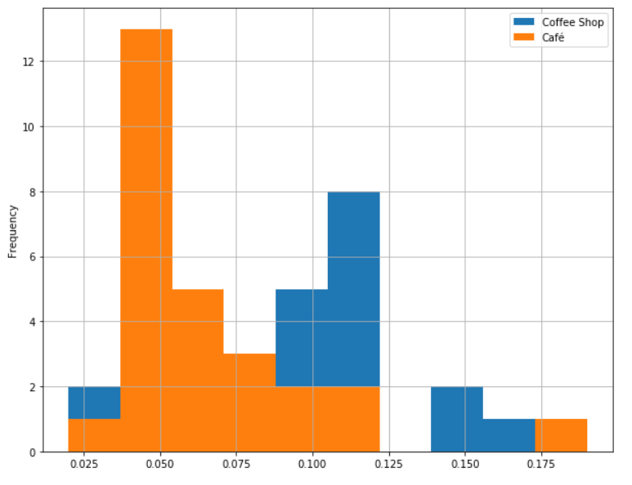
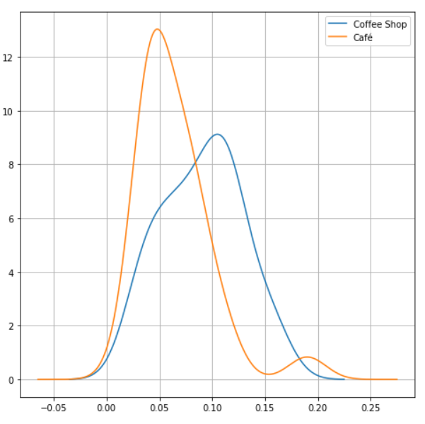
Compare the Coffee shop and Café vs frequency search

Slide 4
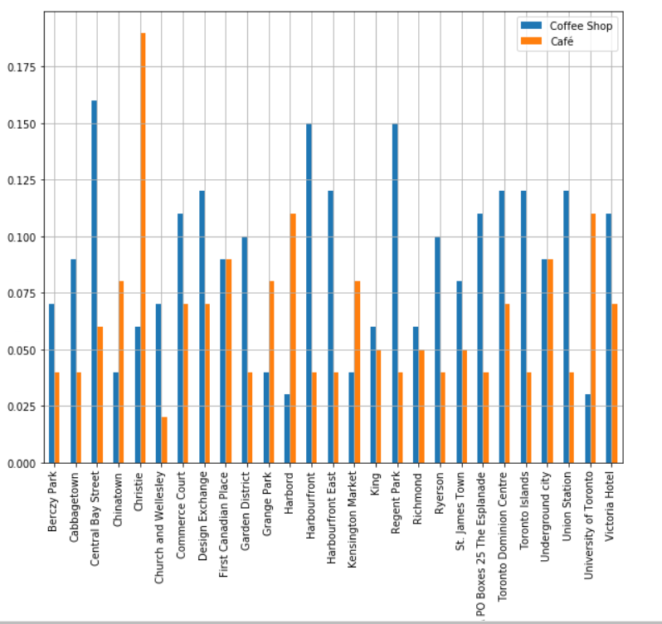
Then review Coffee shop and Café data used k-nearest neighbor vs Neighbourhood.

Slide 5
Conclusion
Identified Café in Christie Neighbourhood is suitable investment for the client.

